Slide 1
A Fresh Start

Slide 2
Agenda
01 | Why the need for a Fresh Start? Overview Pressing Issues
02 | Who are we? Vision, Mission, Guiding Principles BHCHA Board of Trustees Members and Core Volunteers
03 | What is our plan of action? Priorities Updates and Immediate Plans
04 | What do we need from you?

Slide 3
Why the need for a
Fresh Start?
01

Slide 4




Why a Fresh Start?
Transparency
Development
We need transparency in governance and clarity on the financial condition of the HOA.
Our subdivision has not developed as it should; road and drainage systems are not improving, security is lacking and coordination with Barangays is very limited.
Strategy
Professionalism
There is no strategic plan in place, known to the homeowners.
The dissolved HOA neglected to understand and comply with requirements that are critical to maintain professional and legal governance.

Slide 5




Why not collaborate with BHHAI?
Failed Dialogues
Reform and transparency has been asked from BHHAI over the years, but had fallen on deaf ears or taken with hostility.
Proxy Voting Misuse
Professional Capability
An attempt was made to be part of BHHAI leadership in 2022, sadly, they had lost through proxy votes.
BHHAI seems to be run unprofessionally – unorganized books, lack of awareness of basic laws and rules governing HOAs.
Unfit Leadership
BHHAI has proven unfit to lead the community by ignoring basic procedures to ensure their legal existence.
Notes:
Reform and transparency has been asked from BHHAI over the years, but had fallen on deaf ears or taken with hostility. This was done through both dialogue and formal requests.
Mere letters/emails to BHHAI and/or DHSUD were responded to by BHHAI lawyers with thick documents accompanied by threats of legal action – an example is the request for DHSUD to oversee elections
Requests for clarity on fees dismissed by BHHAI; conciliation meetings meant to reconcile parties were responded to by BHHAI’s lawyers instead of the BOD – an example was when Richelle Capellan called into question the 40,000.00 Water Fees questioned since it wasn’t ratified by the majority
Rey Rullan accused of lying when he said that he wasn’t satisfied by the documents provided to him for audit
An attempt was made to be part of BHHAI leadership in 2022, sadly, they had lost through proxy votes.
In 2022, a number of residents tried to run for office during the elections. The number of residents who were present during the elections were less than 50 voters, and yet the current BOD won by over 200 votes. The proxy forms collected by the BOD at the time from lot owners did not indicate who they would like to vote for, instead, the choice was left to the BHHAI BOD at the time.
BHHAI proved that they are unfit to lead the community by ignoring simple procedures to ensure their legal existence.
Prior to the [dissolution] order issued on November 2023, BHHAI has been reminded by DHSUD to file for new articles of incorporation. However, they chose to ignore this reminder.
From the time they were made aware that their AOI had expired, they had half a year, if not more, to file for new articles of incorporation, which they failed to do. Instead, they chose to appeal the order and justify their mistake, and spend the community’s funds on legal fees. The alternative, which was file for new AOI, would have been simpler and less costly.

Slide 6
Pressing Issues
Lack of full transparency, especially on fund management
Road and vicinity maintenance
Association legitimacy
Security concerns
Inconsistent implementation of rules and regulations
Notes:
Lack of full transparency
Financials – initial review of records obtained from DHSUD showed gaps and requests to review full accounting, even by paying members by the dissolved HOA was repeatedly denied or gaslighted
Implementation of rules and regulations without rational or legal basis (no documentation to back up) – when questioned on rules and regulations which require a majority membership vote to be implemented, BHHAI is unable to produce proper documentation and instead resorts to threats through inconveniences (example: Water Fund, Construction Fees, etc.)
Security concerns over the past few years (burglaries, perimeter wall)
Road and vicinity maintenance are inconsistent and dependent on reports
Inconsistencies on implementation of rules and regulations such as commercial establishment controls and delivery fees, among others
Association legitimacy
No order to dissolve BHCHA to date, or negating its certificate of registration
All matters seem to be routed to the lawyers, some of which are fee-based, including administrative concerns which are addressed to the BOD’s implementation of rules and regulations and should not necessarily be considered a legal case
Questions around elections, spend of funds, etc. which the BOD should be capable of answering are routed to their legal counsel
Issues raised to the DHSUD which can initially be addressed by the BOD are routed to their legal counsel (i.e. mediation meetings)
Fighting against an order which need no further proceedings up until the supreme court without a clear end goal in mind

Slide 7
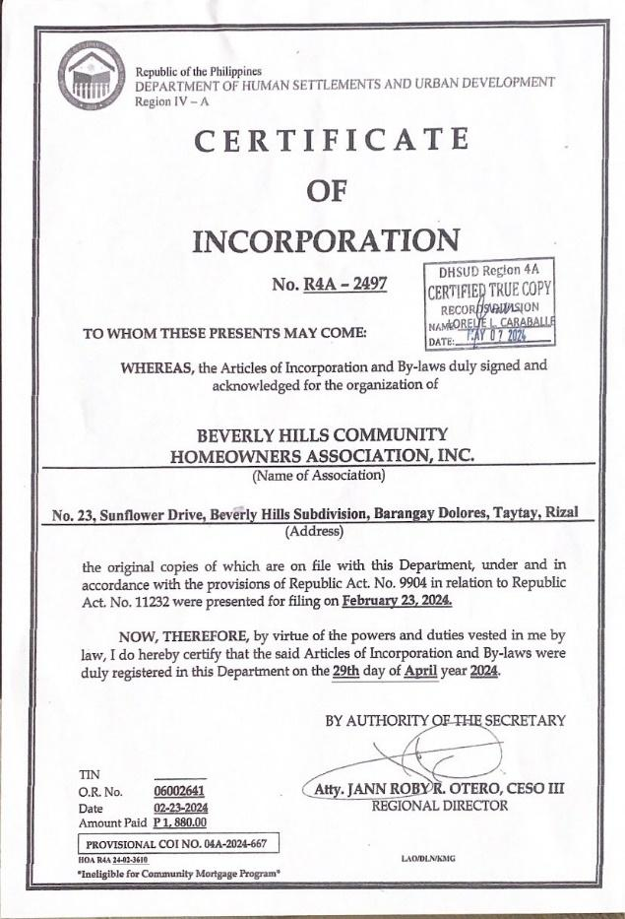
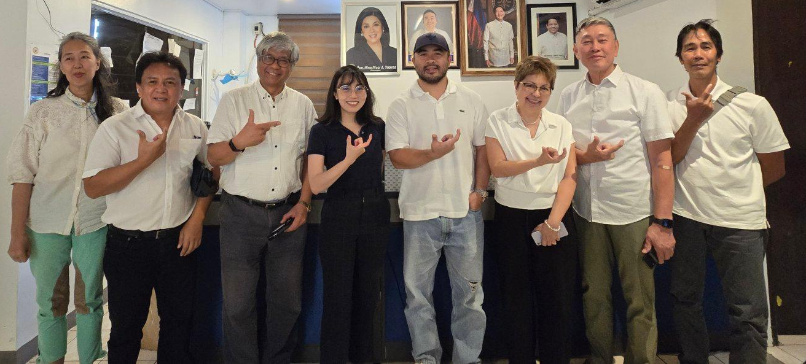
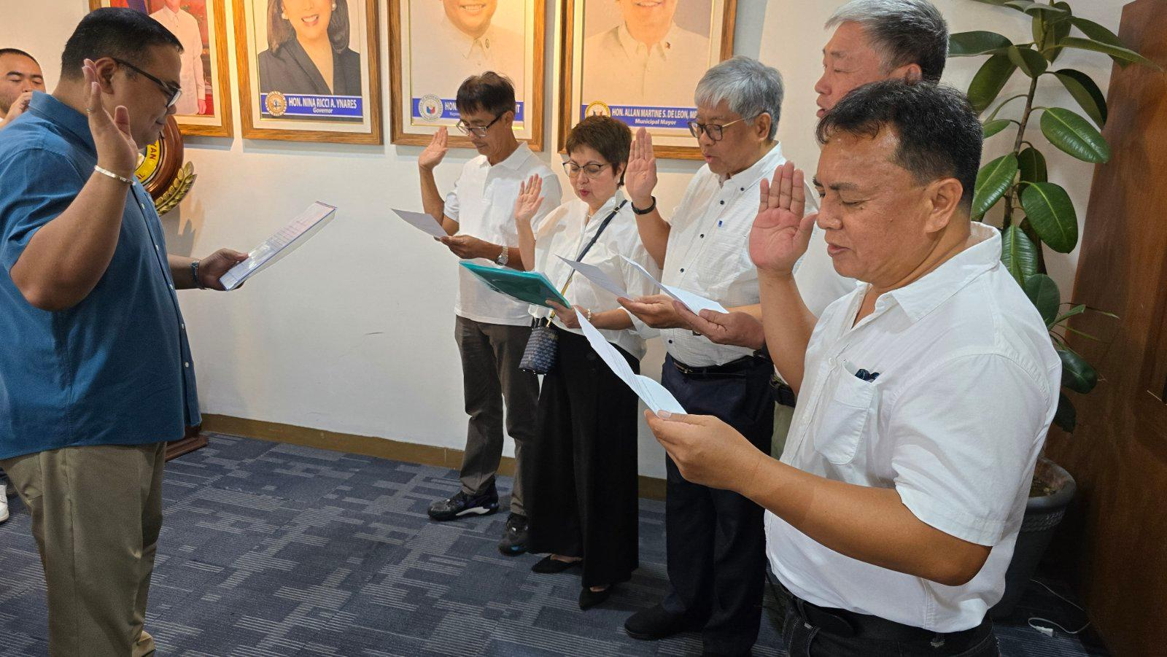
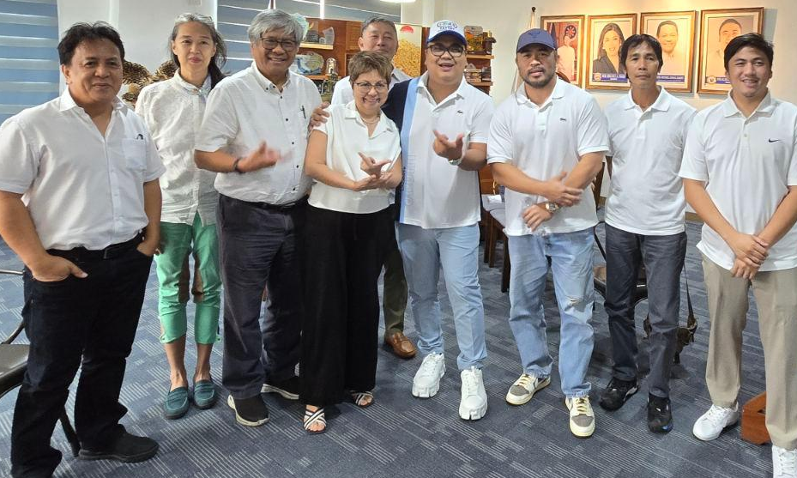
So, we took action!

Slide 8
Who are we?
02

Slide 9
VISION
Inspire a lively community who support and care for one another and the larger community, and reside in a lush, green neighborhood that is safe, sustainable and peaceful.
MISSION
Implement professionally managed programs that promote camaraderie, represent community interests & address pressing concerns and maximize community resources and create a positive impact within and beyond our neighborhood.

Slide 10
GUIDING PRINCIPLES
Professionalism
Integrity
Collaboration
Courage
Purpose-driven
Conducting oneself in a professional manner, guided by sound principles which transcend personal interests, exhibiting competence required and being accountable for all possible outcomes.
Displaying ethical and moral strength which is manifested through honesty, transparency and consistency in actions.
Willingness to work together to achieve a common goal; working with others in a respectful manner, in an inclusive environment where all ideas are heard, to be able to accomplish desired outcomes.
Doing the right thing amidst challenges; having difficult conversations that will effect purposeful change and taking steps to empower the community to take necessary action.
Ensuring that all actions are meaningful and goal-focused; being proactive in advancing community interests.

Slide 11
BHCHA Board of Trustees
Baste Quiniones Jr.
President, Trustee
Myra Reinoso
Mike Castro
Bendette McFarland
Ed Millana
Secretary/Treasurer, Trustee
Trustee
Trustee
Trustee

Slide 12
BHCHA Board of Trustees
Sebastian “Baste” Quiniones, Jr., President and Trustee
He has been a resident of Beverly Hills Subdivision since 2001. He is involved in Industry and NGOs. Currently, the Executive Director of Pilipinas Shell Foundation Inc., an Independent Director of Energy Development Corporation, a Director of Prime Oil and Gas Inc, Chairman of League of Corporate Foundations, Chairman of Mindoro Biodiversity Conservation Foundation. He has over 4 decades of Management experience at Senior Management and Board levels on companies and foundations recognized globally for their superlative performance on governance and societal contributions.
Notes:
Sebastian Quiniones, Jr.
Sebastian “Baste” Quiniones, Jr. has been a resident of Beverly Hills Subdivision since 2001. He
is involved in Industry and NGOs. Currently, the Executive Director of Pilipinas Shell Foundation
Inc., an Independent Director of Energy Development Corporation, a Director of Prime Oil and Gas
Inc, Chairman of League of Corporate Foundations, Chairman of Mindoro Biodiversity
Conservation Foundation. He has over 4 decades of Management experience at Senior
Management and Board levels on companies and foundations recognized globally for their
superlative performance on governance and societal contributions.
Miguel Castro
Miguel “Mang Mike” Castro has been a resident of Beverly Hills Subdivision since 2020. His
professional experience is in the appliance manufacturing industry, where developed his skills in
operations and management. During this time, he served as an officer of the Philippine Appliance
Industry Association for almost 10 years and in the Board of Directors of Laguna Technopark
Association, Inc. for 4 years, where he would later become a consultant.
Myra Reinoso
Myra Reinoso has been a resident of Beverly Hills Subdivision since 2018. She is a finance
professional who has more than 40 years of experience as Finance Consultant and Chief Finance
Officer in both government and private institutions including the Development Bank of the
Philippines, Home Credit Corporation and SMC Infrastructure, among others. Her expertise span
from credit evaluation, infrastructure finance, project finance, retail finance, project development
and finance audit.
Eduardo Millana
Eduardo “Ed” Millana has been a resident of Beverly Hills Subdivision since 2013. He has over 20
years of computer engineering experience covering systems integration, manufacturing and RnD.
He also founded several businesses which comprise of ICT, defense, broadcasting,
telecommunications and media solutions in the Philippines, Hong Kong, Malaysia and USA.
Bernardita McFarland
Bernardita “Bendette” McFarland has been a resident of Beverly Hills Subdivision since 2009, when
she officially relocated from Japan. She has over 40 years of active community engagement here
and abroad including as a leader of the Filipino Community in Tokyo (while teaching in Sophia
University and the Foreign Service Training Institute) and President of Soroptomist International of
Antipolo. She has also been active in the Beverly Hills community since 2009, where she served
two terms as a member of the Board of Governors and Corporate Secretary of subdivision’s then
HOA.

Slide 13
BHCHA Board of Trustees
Miguel “Mang Mike” Castro, Trustee
He has been a resident of Beverly Hills Subdivision since 2020. His professional experience is in the appliance manufacturing industry, where developed his skills in operations and management. During this time, he served as an officer of the Philippine Appliance Industry Association for almost 10 years and in the Board of Directors of Laguna Technopark Association, Inc. for 4 years, where he would later become a consultant.
Notes:
Sebastian Quiniones, Jr.
Sebastian “Baste” Quiniones, Jr. has been a resident of Beverly Hills Subdivision since 2001. He
is involved in Industry and NGOs. Currently, the Executive Director of Pilipinas Shell Foundation
Inc., an Independent Director of Energy Development Corporation, a Director of Prime Oil and Gas
Inc, Chairman of League of Corporate Foundations, Chairman of Mindoro Biodiversity
Conservation Foundation. He has over 4 decades of Management experience at Senior
Management and Board levels on companies and foundations recognized globally for their
superlative performance on governance and societal contributions.
Miguel Castro
Miguel “Mang Mike” Castro has been a resident of Beverly Hills Subdivision since 2020. His professional experience is in the appliance manufacturing industry, where developed his skills in
operations and management. During this time, he served as an officer of the Philippine Appliance Industry Association for almost 10 years and in the Board of Directors of Laguna Technopark
Association, Inc. for 4 years, where he would later become a consultant.
Myra Reinoso
Myra Reinoso has been a resident of Beverly Hills Subdivision since 2018. She is a finance
professional who has more than 40 years of experience as Finance Consultant and Chief Finance
Officer in both government and private institutions including the Development Bank of the
Philippines, Home Credit Corporation and SMC Infrastructure, among others. Her expertise span
from credit evaluation, infrastructure finance, project finance, retail finance, project development
and finance audit.
Eduardo Millana
Eduardo “Ed” Millana has been a resident of Beverly Hills Subdivision since 2013. He has over 20
years of computer engineering experience covering systems integration, manufacturing and RnD.
He also founded several businesses which comprise of ICT, defense, broadcasting,
telecommunications and media solutions in the Philippines, Hong Kong, Malaysia and USA.
Bernardita McFarland
Bernardita “Bendette” McFarland has been a resident of Beverly Hills Subdivision since 2009, when
she officially relocated from Japan. She has over 40 years of active community engagement here
and abroad including as a leader of the Filipino Community in Tokyo (while teaching in Sophia
University and the Foreign Service Training Institute) and President of Soroptomist International of
Antipolo. She has also been active in the Beverly Hills community since 2009, where she served
two terms as a member of the Board of Governors and Corporate Secretary of subdivision’s then
HOA.

Slide 14
BHCHA Board of Trustees
Myra Reinoso, Secretary/Treasurer and Trustee
She has been a resident of Beverly Hills Subdivision since 2018. She is a finance professional who has more than 40 years of experience as Finance Consultant and Chief Finance Officer in both government and private institutions including the Development Bank of the Philippines, Home Credit Corporation and SMC Infrastructure, among others. Her expertise span from credit evaluation, infrastructure finance, project finance, retail finance, project development and finance audit.
Notes:
Sebastian Quiniones, Jr.
Sebastian “Baste” Quiniones, Jr. has been a resident of Beverly Hills Subdivision since 2001. He is involved in Industry and NGOs. Currently, the Executive Director of Pilipinas Shell Foundation
Inc., an Independent Director of Energy Development Corporation, a Director of Prime Oil and Gas Inc, Chairman of League of Corporate Foundations, Chairman of Mindoro Biodiversity
Conservation Foundation. He has over 4 decades of Management experience at Senior Management and Board levels on companies and foundations recognized globally for their superlative performance on governance and societal contributions.
Miguel Castro
Miguel “Mang Mike” Castro has been a resident of Beverly Hills Subdivision since 2020. His professional experience is in the appliance manufacturing industry, where developed his skills in
operations and management. During this time, he served as an officer of the Philippine Appliance Industry Association for almost 10 years and in the Board of Directors of Laguna Technopark
Association, Inc. for 4 years, where he would later become a consultant.
Myra Reinoso
Myra Reinoso has been a resident of Beverly Hills Subdivision since 2018. She is a finance professional who has more than 40 years of experience as Finance Consultant and Chief Finance
Officer in both government and private institutions including the Development Bank of the Philippines, Home Credit Corporation and SMC Infrastructure, among others. Her expertise span
from credit evaluation, infrastructure finance, project finance, retail finance, project development and finance audit.
Eduardo Millana
Eduardo “Ed” Millana has been a resident of Beverly Hills Subdivision since 2013. He has over 20
years of computer engineering experience covering systems integration, manufacturing and RnD.
He also founded several businesses which comprise of ICT, defense, broadcasting,
telecommunications and media solutions in the Philippines, Hong Kong, Malaysia and USA.
Bernardita McFarland
Bernardita “Bendette” McFarland has been a resident of Beverly Hills Subdivision since 2009, when
she officially relocated from Japan. She has over 40 years of active community engagement here
and abroad including as a leader of the Filipino Community in Tokyo (while teaching in Sophia
University and the Foreign Service Training Institute) and President of Soroptomist International of
Antipolo. She has also been active in the Beverly Hills community since 2009, where she served
two terms as a member of the Board of Governors and Corporate Secretary of subdivision’s then
HOA.

Slide 15
BHCHA Board of Trustees
Eduardo “Ed” Millana, Trustee
He has been a resident of Beverly Hills Subdivision since 2013. He has over 20 years of computer engineering experience covering systems integration, manufacturing and RnD. He also founded several businesses which comprise of ICT, defense, broadcasting, telecommunications and media solutions in the Philippines, Hong Kong, Malaysia and USA.
Notes:
Sebastian Quiniones, Jr.
Sebastian “Baste” Quiniones, Jr. has been a resident of Beverly Hills Subdivision since 2001. He is involved in Industry and NGOs. Currently, the Executive Director of Pilipinas Shell Foundation
Inc., an Independent Director of Energy Development Corporation, a Director of Prime Oil and Gas Inc, Chairman of League of Corporate Foundations, Chairman of Mindoro Biodiversity
Conservation Foundation. He has over 4 decades of Management experience at Senior Management and Board levels on companies and foundations recognized globally for their superlative performance on governance and societal contributions.
Miguel Castro
Miguel “Mang Mike” Castro has been a resident of Beverly Hills Subdivision since 2020. His professional experience is in the appliance manufacturing industry, where developed his skills in
operations and management. During this time, he served as an officer of the Philippine Appliance Industry Association for almost 10 years and in the Board of Directors of Laguna Technopark
Association, Inc. for 4 years, where he would later become a consultant.
Myra Reinoso
Myra Reinoso has been a resident of Beverly Hills Subdivision since 2018. She is a finance professional who has more than 40 years of experience as Finance Consultant and Chief Finance
Officer in both government and private institutions including the Development Bank of the Philippines, Home Credit Corporation and SMC Infrastructure, among others. Her expertise span
from credit evaluation, infrastructure finance, project finance, retail finance, project development and finance audit.
Eduardo Millana
Eduardo “Ed” Millana has been a resident of Beverly Hills Subdivision since 2013. He has over 20 years of computer engineering experience covering systems integration, manufacturing and RnD. He also founded several businesses which comprise of ICT, defense, broadcasting, telecommunications and media solutions in the Philippines, Hong Kong, Malaysia and USA.
Bernardita McFarland
Bernardita “Bendette” McFarland has been a resident of Beverly Hills Subdivision since 2009, when
she officially relocated from Japan. She has over 40 years of active community engagement here
and abroad including as a leader of the Filipino Community in Tokyo (while teaching in Sophia
University and the Foreign Service Training Institute) and President of Soroptomist International of
Antipolo. She has also been active in the Beverly Hills community since 2009, where she served
two terms as a member of the Board of Governors and Corporate Secretary of subdivision’s then
HOA.

Slide 16
BHCHA Board of Trustees
Bernardita “Bendette” McFarland, Trustee
She has been a resident of Beverly Hills Subdivision since 2009, when she officially relocated from Japan. She has over 40 years of active community engagement here and abroad including as a leader of the Filipino Community in Tokyo (while teaching in Sophia University and the Foreign Service Training Institute) and President of Soroptomist International of Antipolo. She has also been active in the Beverly Hills community since 2009, where she served two terms as a member of the Board of Governors and Corporate Secretary of subdivision’s then HOA.
Notes:
Sebastian Quiniones, Jr.
Sebastian “Baste” Quiniones, Jr. has been a resident of Beverly Hills Subdivision since 2001. He is involved in Industry and NGOs. Currently, the Executive Director of Pilipinas Shell Foundation
Inc., an Independent Director of Energy Development Corporation, a Director of Prime Oil and Gas Inc, Chairman of League of Corporate Foundations, Chairman of Mindoro Biodiversity
Conservation Foundation. He has over 4 decades of Management experience at Senior Management and Board levels on companies and foundations recognized globally for their superlative performance on governance and societal contributions.
Miguel Castro
Miguel “Mang Mike” Castro has been a resident of Beverly Hills Subdivision since 2020. His professional experience is in the appliance manufacturing industry, where developed his skills in
operations and management. During this time, he served as an officer of the Philippine Appliance Industry Association for almost 10 years and in the Board of Directors of Laguna Technopark
Association, Inc. for 4 years, where he would later become a consultant.
Myra Reinoso
Myra Reinoso has been a resident of Beverly Hills Subdivision since 2018. She is a finance professional who has more than 40 years of experience as Finance Consultant and Chief Finance
Officer in both government and private institutions including the Development Bank of the Philippines, Home Credit Corporation and SMC Infrastructure, among others. Her expertise span
from credit evaluation, infrastructure finance, project finance, retail finance, project development and finance audit.
Eduardo Millana
Eduardo “Ed” Millana has been a resident of Beverly Hills Subdivision since 2013. He has over 20 years of computer engineering experience covering systems integration, manufacturing and RnD. He also founded several businesses which comprise of ICT, defense, broadcasting, telecommunications and media solutions in the Philippines, Hong Kong, Malaysia and USA.
Bernardita McFarland
Bernardita “Bendette” McFarland has been a resident of Beverly Hills Subdivision since 2009, when she officially relocated from Japan. She has over 40 years of active community engagement here and abroad including as a leader of the Filipino Community in Tokyo (while teaching in Sophia University and the Foreign Service Training Institute) and President of Soroptomist International of Antipolo. She has also been active in the Beverly Hills community since 2009, where she served two terms as a member of the Board of Governors and Corporate Secretary of subdivision’s then HOA.

Slide 17
What is our plan of action?
03

Slide 18
Immediate Objectives
Transparency of Governance: financials online, contracts and MoA’s available for scrutiny
By-laws and Regulations as per DHSUD and best practices
Committees of volunteers for specific areas of operations
Barangays (Dolores Taytay and Antipolo) assisting the Subdivision in security and emergency response
Strategic review of road ownership (Antipolo - already donated to City)
Address issues via discussions with clear timeline on actions

Slide 19
Priorities
Complete legal documentation requirements
Put basic operational requirements in place
Address security concerns
Secure LGU and other partnerships
Assess and address immediate safety/maintenance concerns
Encourage community involvement
Notes:
Complete legal documentation
Put basic operational requirements in place
Address security concerns
Secure LGU partnerships
Encourage community involvement

Slide 20
Updates and Immediate Plans
Complete legal documentation requirements
Certificate of Incorporation issued; supporting documents submitted
BHCHA By-laws and Rules & Regulations approved and submitted to DHSUD
Bank accounts opened
No orders from legal governing bodies to stop operations
Notes:
Certificate of Incorporation issued; supporting documents submitted
BHCHA By-laws approved and submitted to DHSUD – approved in a GMM, available for review
BHCHA Rules & Regulations and Schedule of Fees and Dues approved and submitted to DHSUD – approved in a GMM, available for review
No orders from legal governing bodies to stop operations – doing minimal at this point to avoid major disruptions

Slide 21
Updates and Immediate Plans
Put basic operational requirements in place
Satellite office set-up and office staff hired
Seed money collected from current members; projections created for the coming year
Permits (new constructions), application for membership and other basic member requirements ready
Website to be ready in time for the Town Hall
Notes:
Can discuss financial here

Slide 22
Updates and Immediate Plans
Address security concerns
Security assessment conducted by an external party; recommendations submitted
Strengthen partnership with LGUs
Implement new security measures and put new security agency in place
Creation of a Security Committee and Neighborhood Watch

Slide 23
Updates and Immediate Plans
Secure LGU and other partnerships
MoA with Barangay Beverly Hills (Antipolo), Barangay Dolores Poblacion (Taytay) and BHCHA prepared
Assess subdivision maintenance requirements and meet with LGUs to check where they can support
BOT to join networks of HOAs in Antipolo for information and best practices

Slide 24
Updates and Immediate Plans
Assess and address immediate safety/maintenance concerns
Assess road conditions and partner with LGUs to address immediate safety and maintenance concerns
Update (and implement) rules and regulations to address traffic and noise concerns

Slide 25
Updates and Immediate Plans
Encourage community involvement
Present BHCHA plans in an open Town Hall on January 18
Disseminate information campaigns via newsletters, social media and other online communication platforms
Form community committees headed by volunteers: Peace and Order, Audit, Legal and Communications, Grievance, Environment and Maintenance, Social Affairs, Regulation of Non-residential Activities, Election
Notes:
Peace and Order (inc. DRMM, Security) – Rodel Livelo
Audit – Reynaldo Rullan
Legal and Communications – Ed Millana
Grievance – Myra Reinoso
Environment and Maintenance – Kap Jimboy Rico
Social Affairs (inc. GAD, Community, Kasambahay, Livelihood) – Richelle Capellan
Regulation of Non-residential Activities (inc. Construction, Businesses) - Atty
Election Committee

Slide 26
What do we need from you?
04

Slide 27
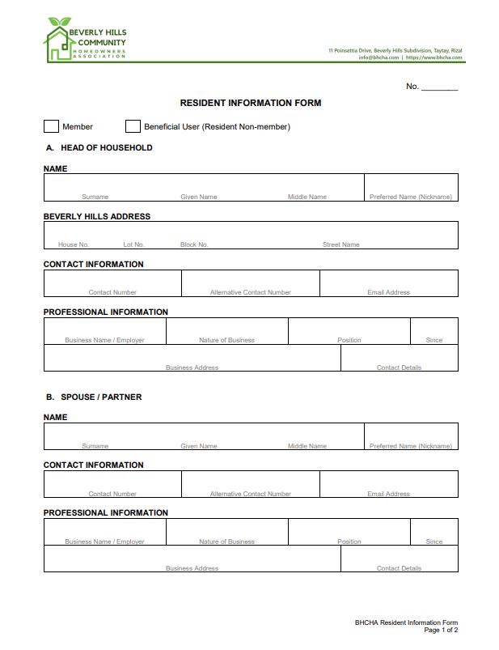
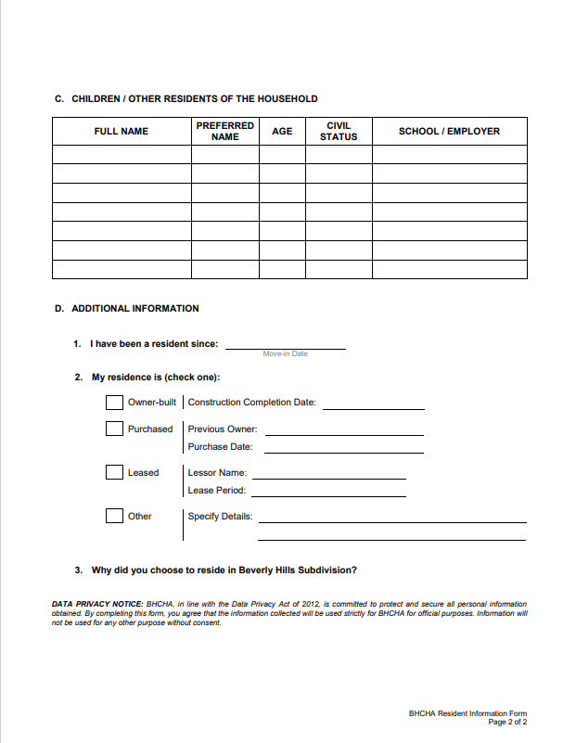
Resident Information

Slide 28
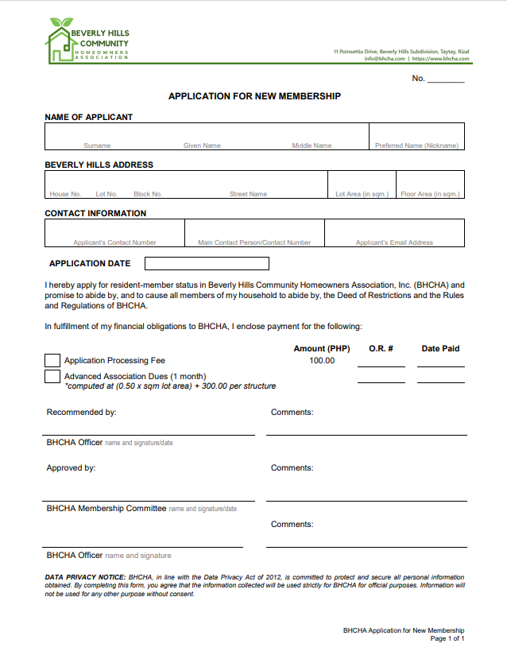
Support
Join as Member or fulfill obligations as Beneficial User
Encourage people to be informed

Slide 29
We would love to hear your views and guidance!
Let’s all work together towards a Fresh Start.

Slide 31
APPENDIX
00

Slide 32
Does this mean that BHCHA is illegal?
BHCHA was issued a Certificate of Registration by DHSUD.
On the other hand, BHHAI’s registration was revoked by DHSUD, and an order affirming their dissolution was issued.
Based on these and other legal documentation, BHCHA continues to operationalize unless their registration is formally revoked by the authorized body, DHSUD.
Notes:
At this time, we respect BHHAI’s right to bring their case until the Office of the President. And so we operate with our current volunteers and members so as not to cause disruption to the community. BHHAI “fighting” this legally and publicly causes disruption, while we are focused on disseminating facts without assumptions or opinions. We did, at one point, engage in “tarp wars” but realized that the best thing we can do is to provide an alternative to residents before trying to gain the community’s support.
DHSUD has already denied both Appeals by BHHAI, not only because they failed to meet the requirements and deadlines for an appeal, but more so because they failed to comply with the requirements to be a legal entity resulting to Automatic Dissolution by operation of law.
DHSUD has already provided legal authority to BHCHA through issuance of its Certificate of Registration. The mere issuance of this certificate is proof that the Order for Automatic Dissolution was upheld by DHSUD, given that by law, no subdivision can have more than one HOA.
While BHHAI continues to appeal their existence to the Office of the President, no revocation of BHCHA’s Certificate of Registration has been issued. Thus, BHCHA is operating within their legal rights as the Homeowner’s Association for Beverly Hills.

Slide 33
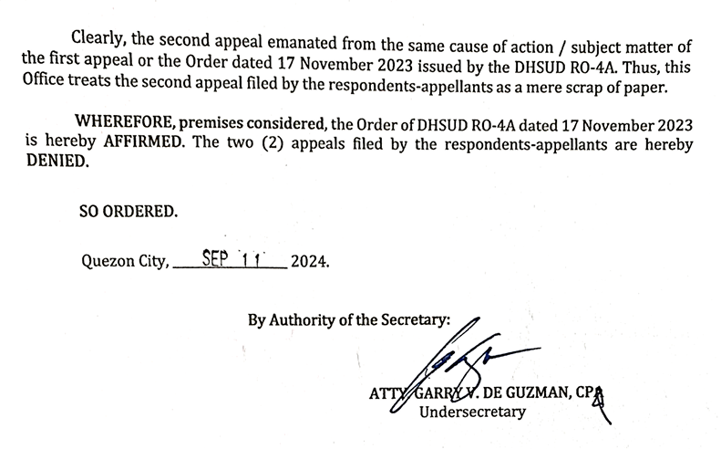
What is your stand on BHHAI’s appeal?
We believe that ignoring “mere technicalities”, especially if done repeatedly, is a symptom of poor governance.
Events leading to the
affirmation of BHHAI’s
dissolution was not caused
by there technicalities, but
by their repeated disregard
for rules and laws set by the
HOA governing body.
Notes:
Prior to the petition for the dissolution of BHHAI, there were numerous complaints filed relating to fees and other rules imposed by BHHAI, requiring ratification of the majority of the membership, were not met. When asked for proof that these were ratified by the majority, their answer was for the complainants to prove that they weren’t ratified. All these were put on hold when the petition for dissolution was received, as their existence as an organization will have a direct impact on these complaints.

Slide 34
What will happen to the Subdivision if BHHAI is dissolved?
What will happen to community services?
Our response: Here’s an alternative HOA who aims to address the community’s concerns which BHHAI has failed to do so over the years.

Slide 35
What about Basic Services provided by HOA?
Security at the gate is a primary concern, thus, will a main priority
Security in the subdivision (i.e. roving, security and emergency response, etc.) will be coordinated by Barangay Beverly Hills in a MoA with Barangay Dolores Taytay; a smaller security force will be needed as Brgy. Tanods will supplement the need
Garbage collection is already done by LGU; we do not have an MRF set up - this is something to plan for
Construction regulation will be done by the HOA but with the right level of control
Emergency response will be coordinated with the Barangays - there is a plan to engage homeowners to assist each other

Slide 36
What is the Timeline?
16 September: members meeting to approve revised Bylaws (note: DHSUD already approved new Bylaws)
End September: all office-related items and operational processes ready
TBD Planned: control of gate (we want a smooth transition)

Slide 37
What about the dissolved Association?
We are open to engagement
We do NOT plan to get control over their bank accounts – they will need to give full reconciliation of accounts and return construction bonds to new builds.
They will need to wind-up operations and handle the various contracts with security and staff

Slide 38
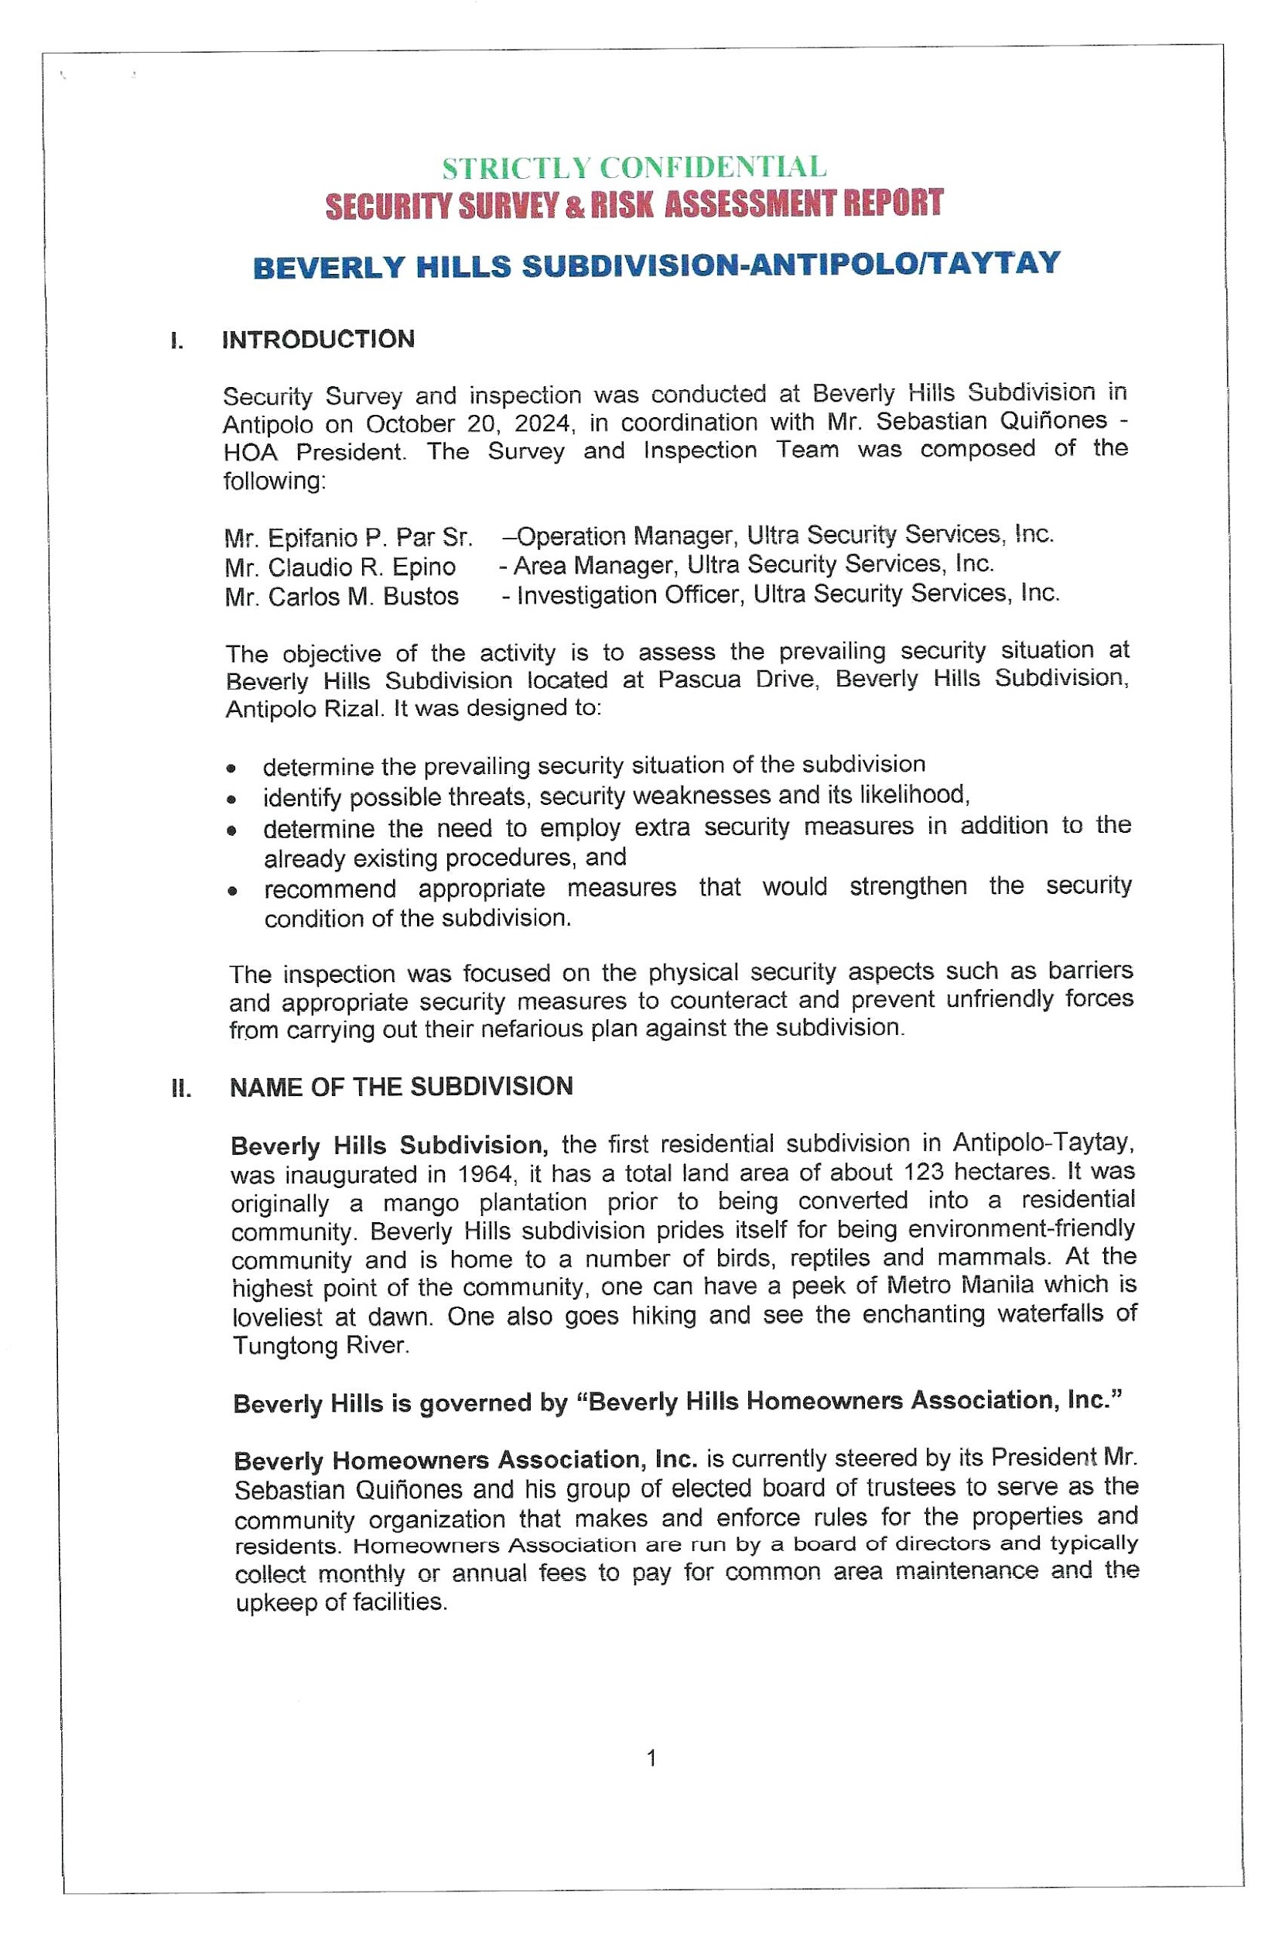
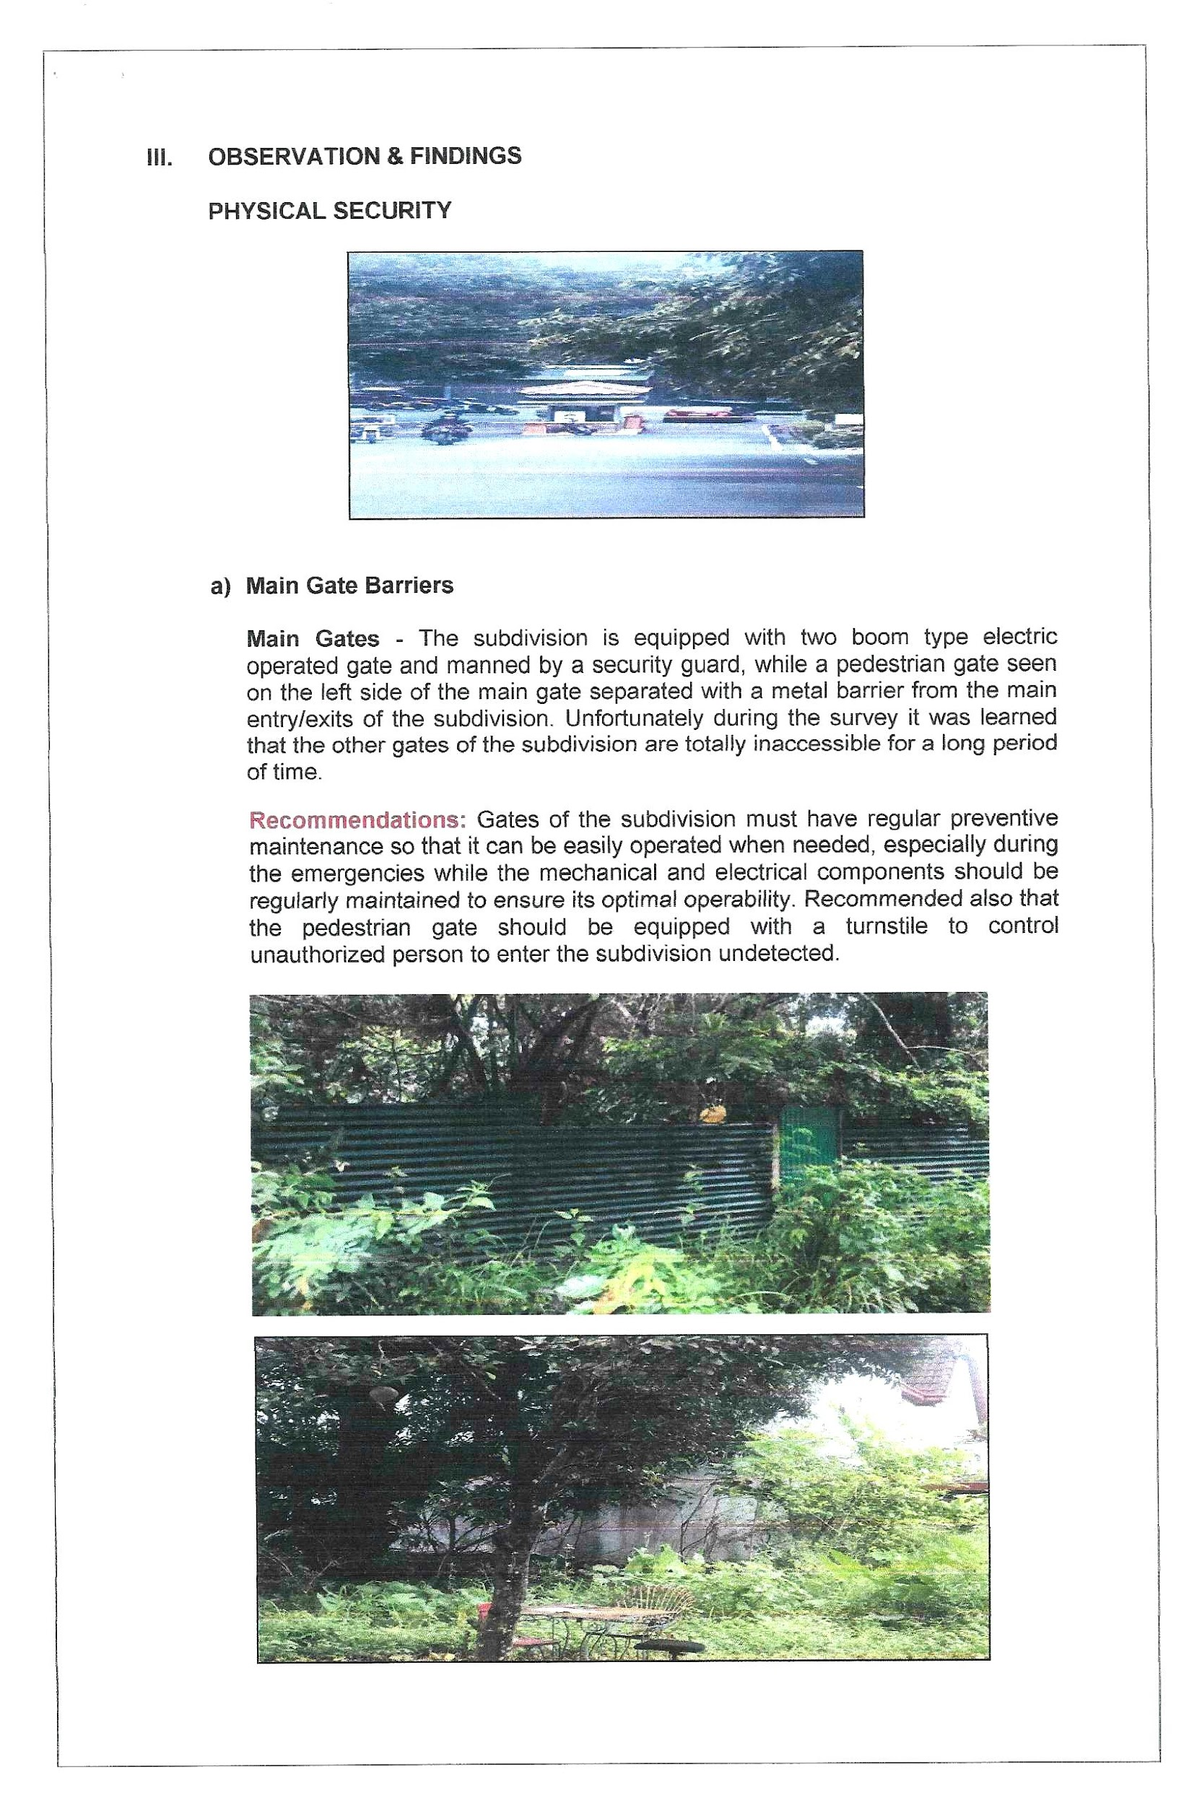

Slide 39
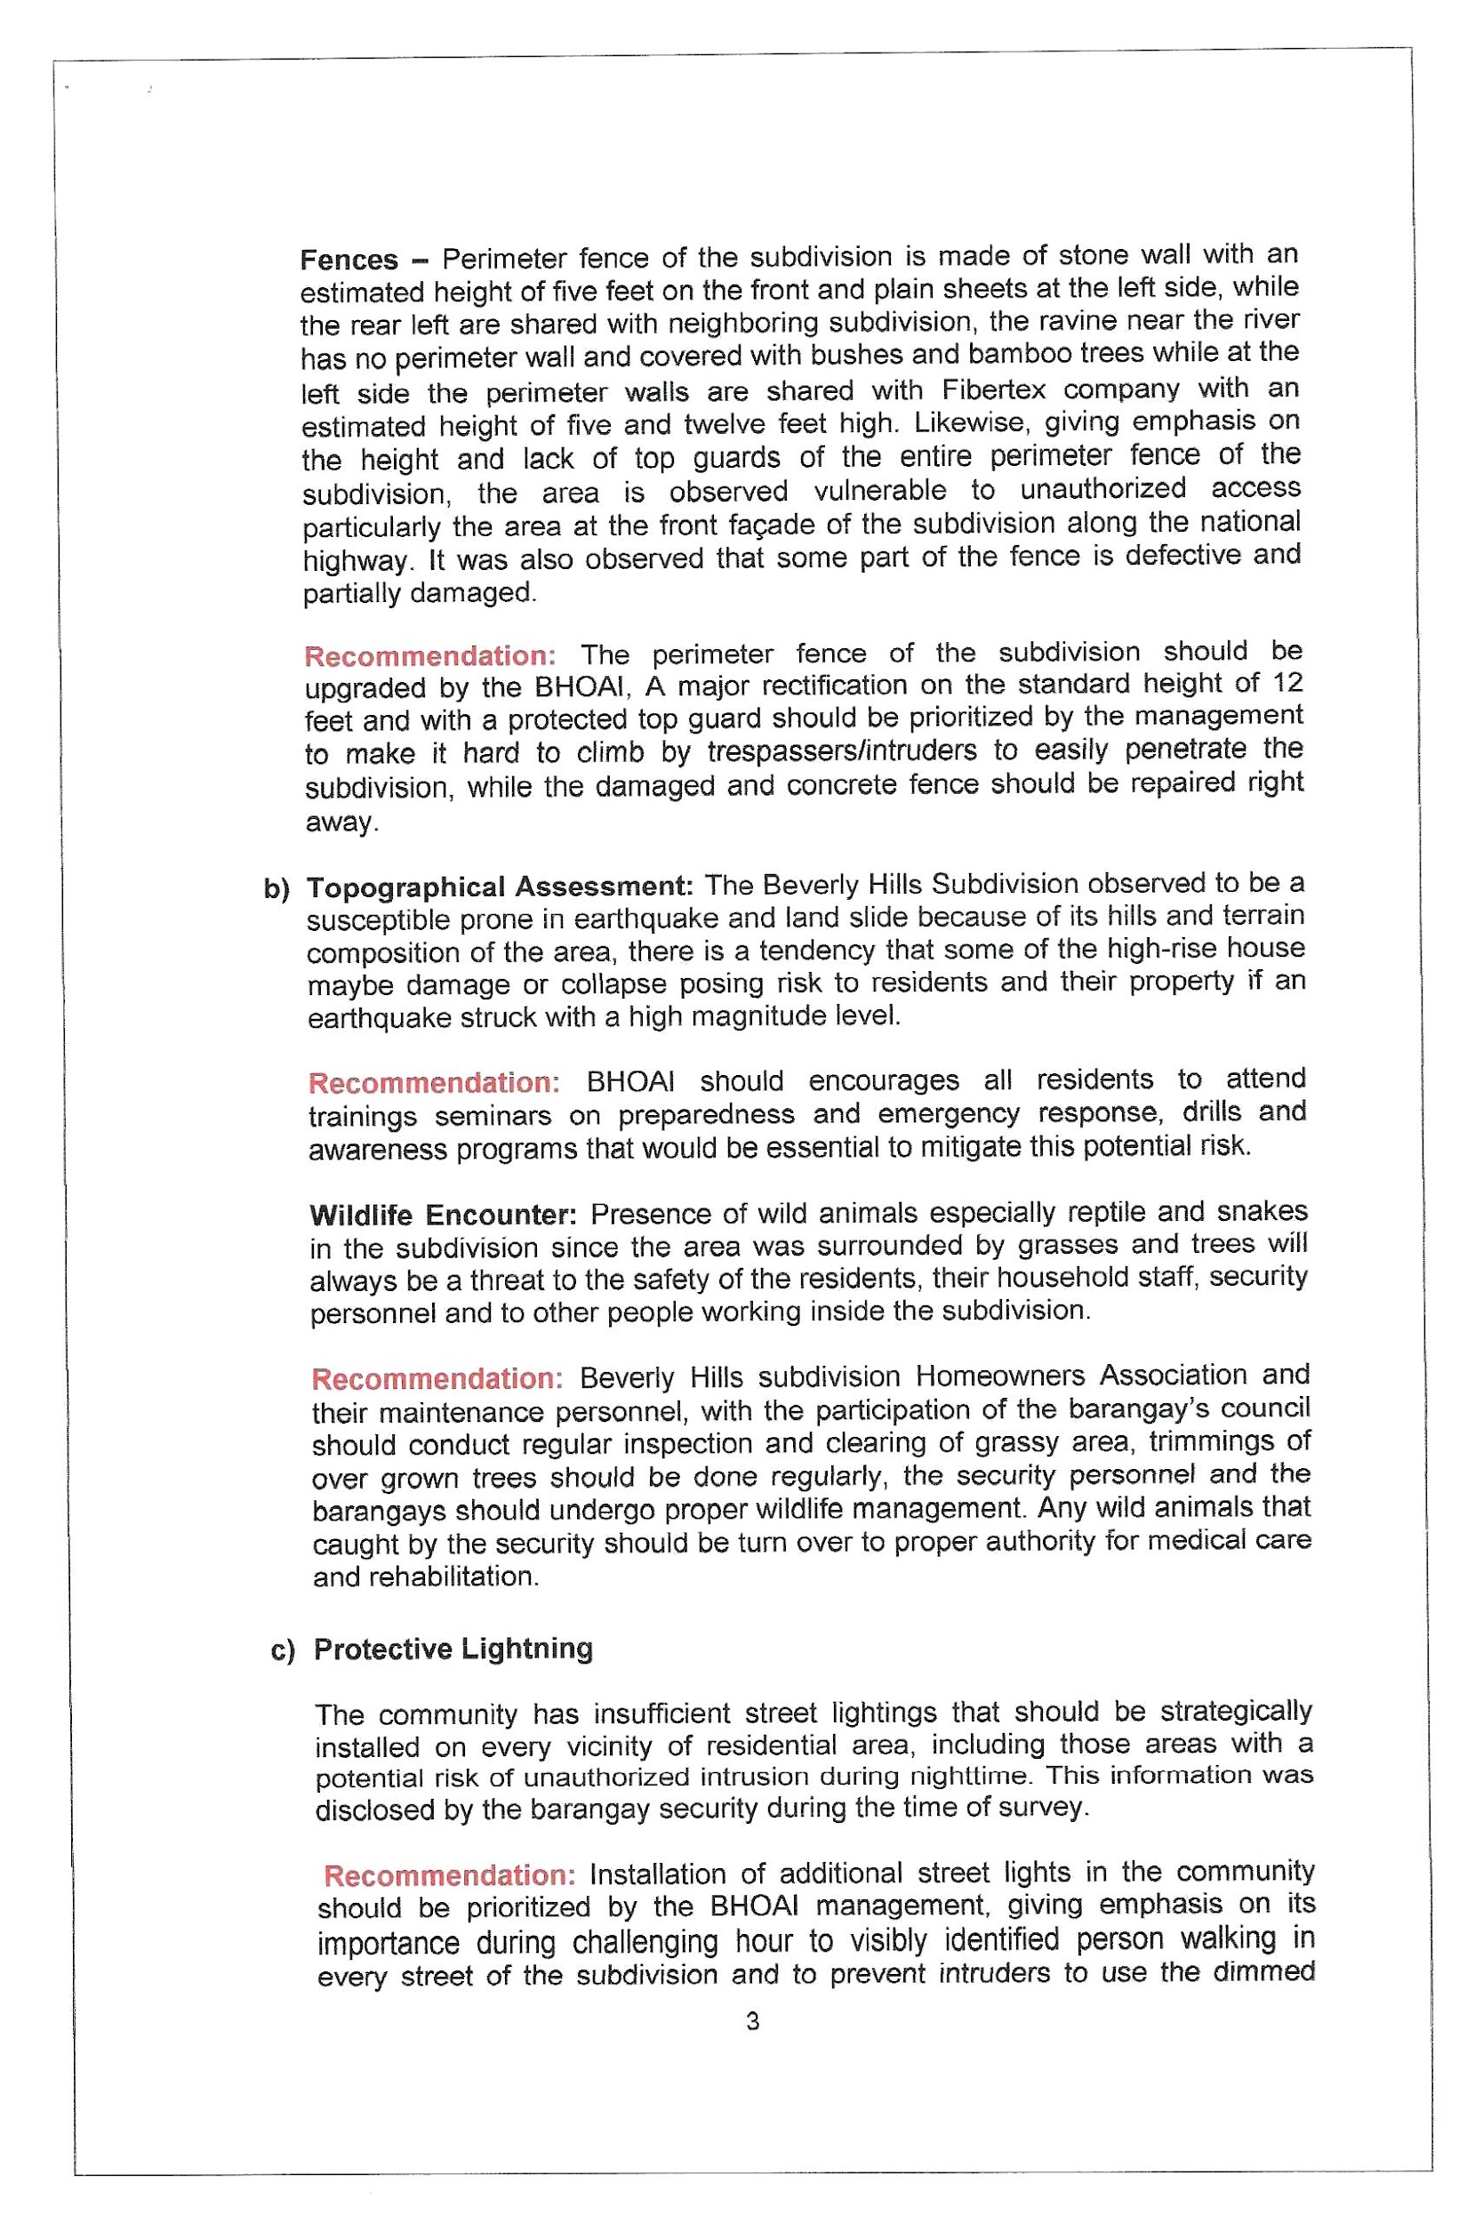
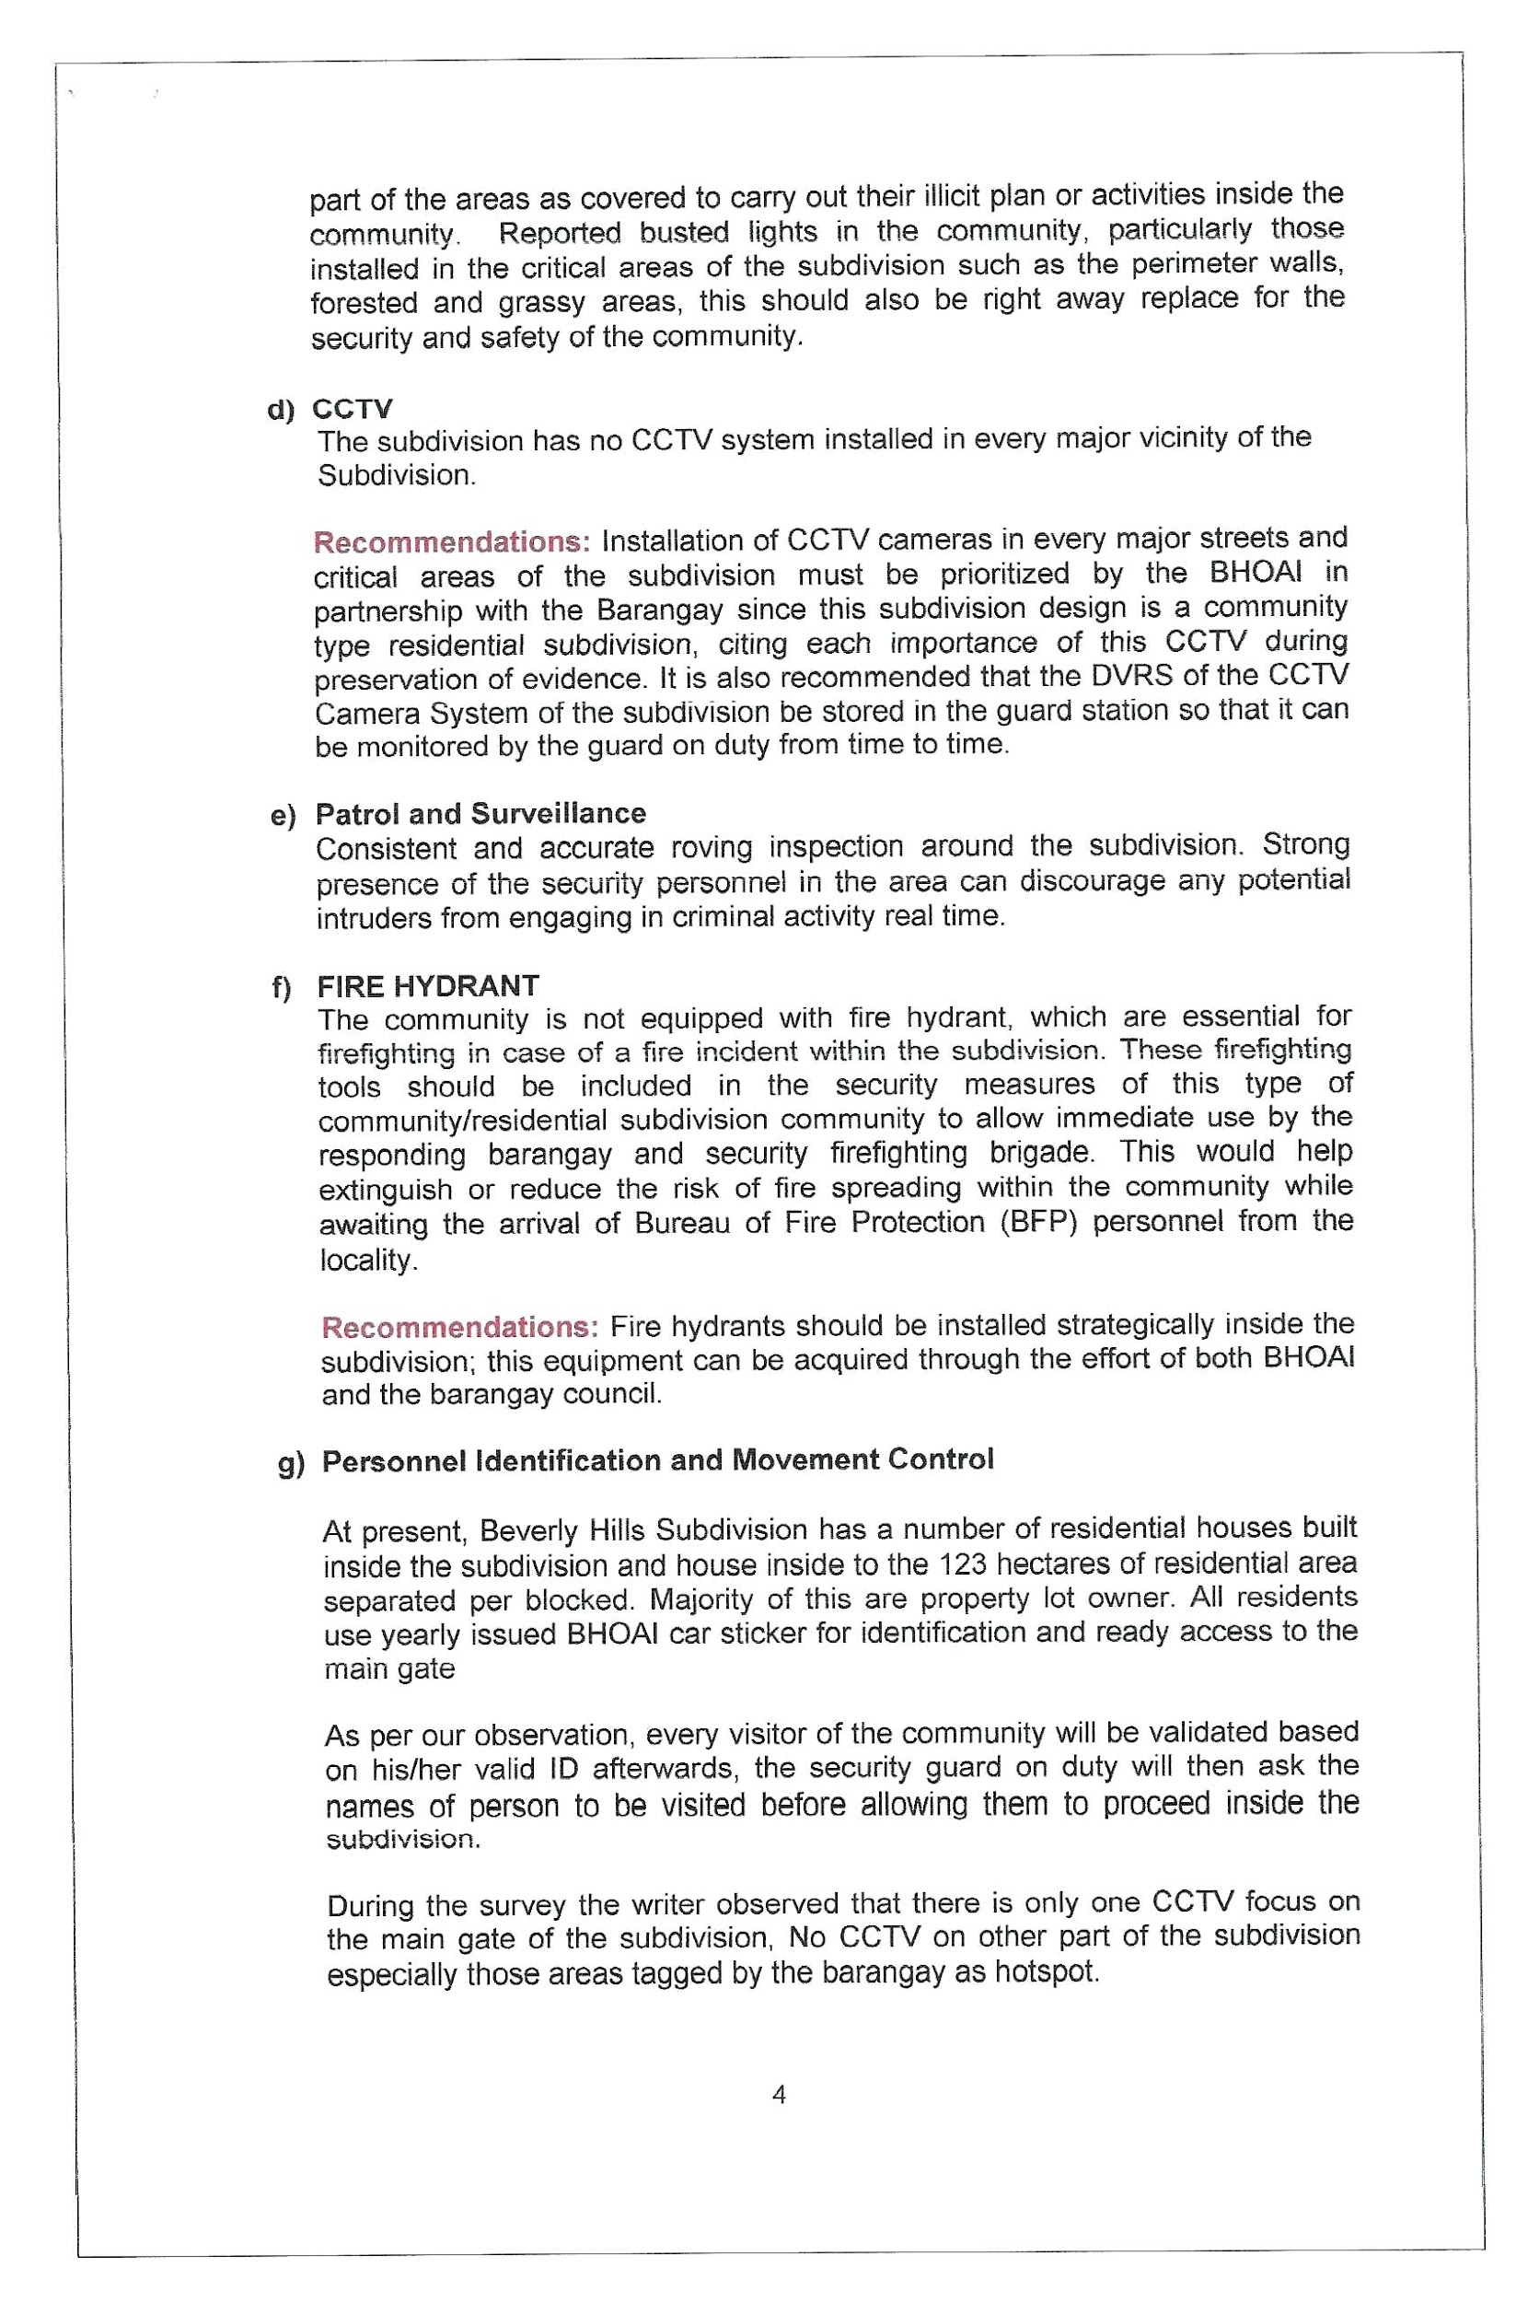

Slide 40
